Slide 1
Gunshot audio Classification

Slide 2
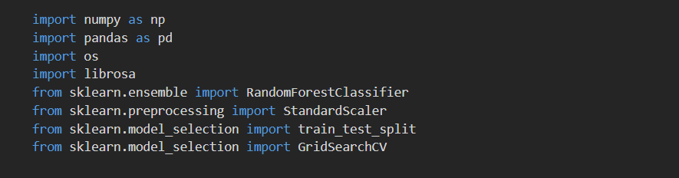
Import library

Slide 3
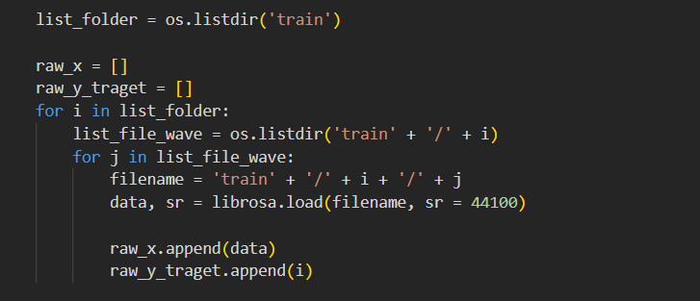
Used librosa load file

Slide 4
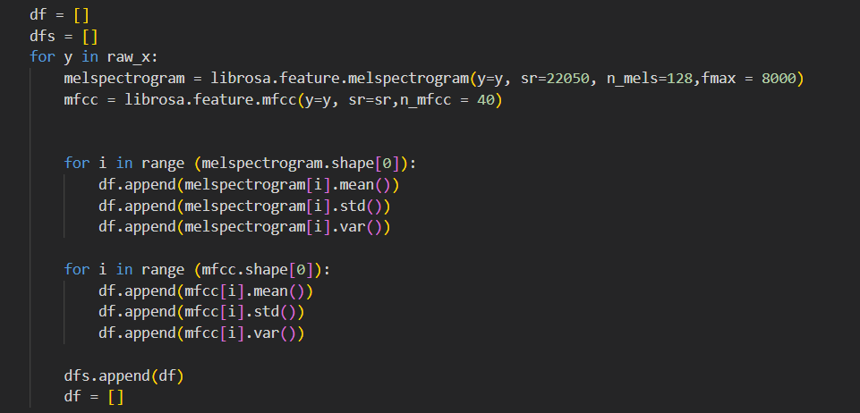
Librosa feature

Slide 5

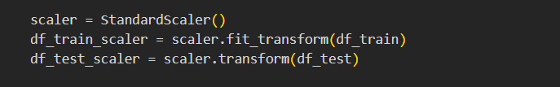
StandardScaler

Slide 6
Train test split

Slide 7
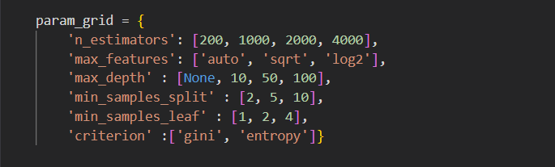
GridSearchCV

Slide 8




Fit model

Slide 9





Prediction

Slide 10
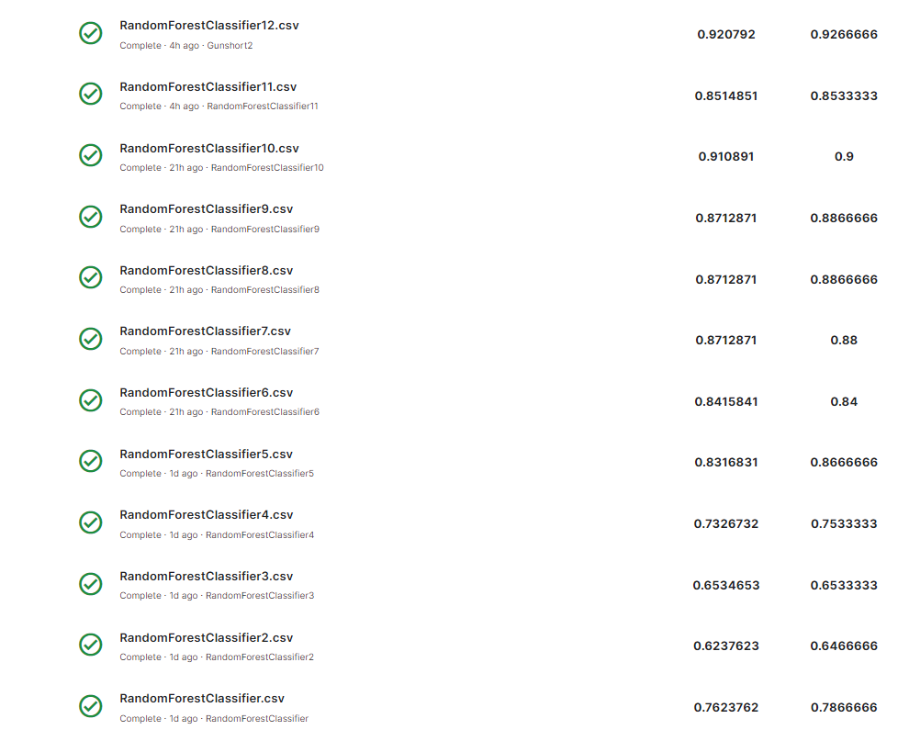
Submission

Slide 11
Thank you

